Slide 1
Recommendation System
For OCL Constraints
Amit Wolf Idan Albilia Ohad Nave
Mentors:
Prof. Arnon Sturm Dr. Rami Puzis

Slide 2
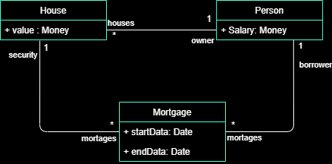
Object Constraint Language(OCL)
Language for specifying constraints on models and pre or post-conditions on operations.
A simple example of OCL constraint - from free text to a valid OCL on an existing UML model :
To OCL
The start of a mortgage is before its end date
Context Mortage
Invariant: startData < endDate

Slide 3
PROJECT PROBLEM
Software developers struggle writing valid OCL constraints due its un-familiar syntax.
In this project we will develop a recommendation system for OCL constraints using machine learning techniques.
in
Recommendation System
out
OCL Recommendation
Model
Model
OCL Recommendation
OCL Recommendation

Slide 4
So Far
Validate Constraints
Feature Extraction
Get Raw Data
Validate each constraint compared to his model structure, using ‘Dresden tool-kit’.
Extract constraint features:
- From the AST *
- From our database
- Based on domain Classification *
Get large dataset of different models.
AST
Data
Parsing
Feature Extraction
Final Database
Validate
Initial Parsing
AST
Final Database
Parse each XML model and create initial database.
Get abstract-syntax-tree of each constraint using ‘USE’ software API
Final database including
Model, Object, Relation and Constraint features
* achieved during the hackathon
www.free-powerpoint-templates-design.com

Slide 5
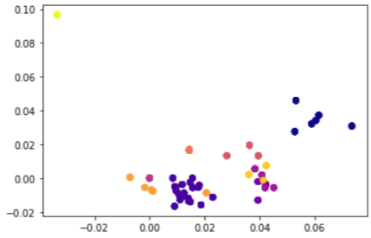
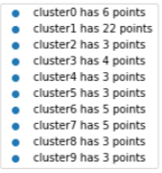
Domain Classification
Using Word-Embedding and DBSCAN algorithm on each model’s object names in order to cluster our models based on their domain.
Out of 318 models only 60 were clustered properly and not considered as noise.
While examining the cluster results, we didn’t find significant similarities between models.

Slide 6
Reduced Problem
At the start of the process we created a model that approaches a reduced binary version of our problem - whether object is context in given constraint or it is only referenced.
in
Recommendation System
out
Is Context to OCL – Yes/No
Object
Object
Is Referenced by OCL – Yes/No

Slide 7
Reduced Problem Results
Selected features for each Object
RelationNum | AttributeNum | is_abstract | inherits
# | # | bit | bit
15,000 Objects using oversampling – 5000 are Label-positive, 10000 are Label-negative
Classify object as a context for a constraint:
Actual positive | GNB | KNeighbors | Random Forest
3005 | 0.356 | 0.707 | 0.706
Classify object as referenced by a constraint:
Actual positive | GNB | KNeighbors | Random Forest
1786 | 0.418 | 0.715 | 0.724

